Slide 1
Amazon Farm
Performance/dynamic pricing
Team #5
Jiongfeng Chen ID: 010830105
Haoda Weng ID: 010720047
Xinlei Yang ID: 010804703
Danyang Zhang ID:010277254
Sheng Zhou ID: 010804677

Slide 2
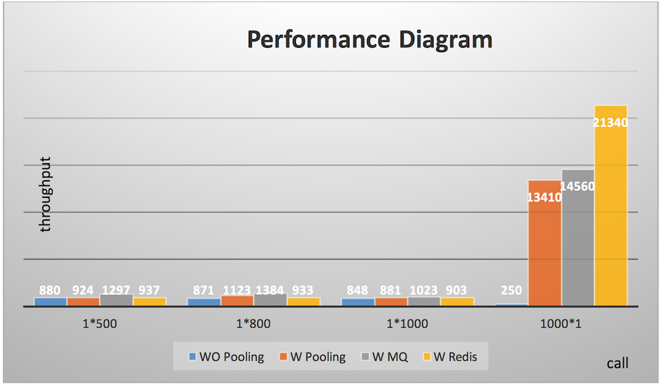
Notes:
Briefly describe the graph. Processing time decreases Concurrent blue server down

Slide 3
Dynamic Pricing
max_revenue := 0
price := LOWER_BOUNDARY
do
sales := Σ(sales volume in a period)
revenue := price * sales
if revenue > max_revenue
price = price*K
max_revenue = revenue
else
break
while (true)
Op
K default value: 1.1 K= f(season, weather, and other factors)
Period (time interval) = {weekly, daily}
Notes:
The dynamic price algorithm is based on greedy design which pursuit the max revenue.
The price will be determined at the beginning of every period. The period can be as short as, or as long as … It depends on what kind of product we want to set the price. Fruit like banana or fresh vegetable.
(The price will start from a preset value as lower boundary.)
The price will stop increasing when the actual revenue is less than the max revenue. k=function(Weather, season), initial value can be 1.1.

Slide 4
Features
Delivery algorithm
Based on credit allocate delivery order
https://docs.google.com/presentation/d/1RZcfXNhiMSayrLg4Q5ctHSbIB-wB-Cqt6jEPWO7F9XQ/edit#slide=id.g13f111c51c_0_2

